Slide 1
The Islamia University of Bahawalpur
Explainable Identification of Human vs.
LLM-Generated Text: A Review
MSCS Research Methods — Term Proposal Review
Presented by: Jawwad Ahmad | F25NDOCS3W04013 | MSCS 2nd Semester
Supervisor: Dr. Ahmad Niaz | Assistant Professor, CS Department
April 2026

Slide 2
Presentation Outline
1
Introduction & Motivation
5
Comparative Analysis
2
Background — LLMs, XAI, LIME & SHAP
6
Research Gaps & Future Directions
3
Methodology — PRISMA Framework
7
Conclusion & Key Takeaways
4
Thematic Literature Review

Slide 3
01 / Introduction
Why does this problem matter?
Academia
Journalism
Medicine
AI submissions undermine integrity of assessment
Synthetic content erodes public trust in news
Unattributed AI text creates serious ethical risk
Accurate detection alone is not enough — systems must be transparent, explainable, and accountable.

Slide 4
02 / Background
LLMs, Detection & Explainable AI
Large Language Models
Explainable AI (XAI)
Transformer-based neural networks trained on vast text corpora
Generate fluent, coherent text via autoregressive decoding
GPT-4, Llama, Claude, Gemini — outputs resemble human prose
Create a serious detection challenge in academic & professional contexts
LIME
SHAP
Local perturbation-based attribution. Fast, flexible, token-level.
Game-theory Shapley values. Consistent, reproducible, additive.
Both are: post-hoc · local · model-agnostic → apply to any classifier
Ante-hoc vs. post-hoc; local vs. global
Make black-box detectors auditable
Surface token-level linguistic signals

Slide 5
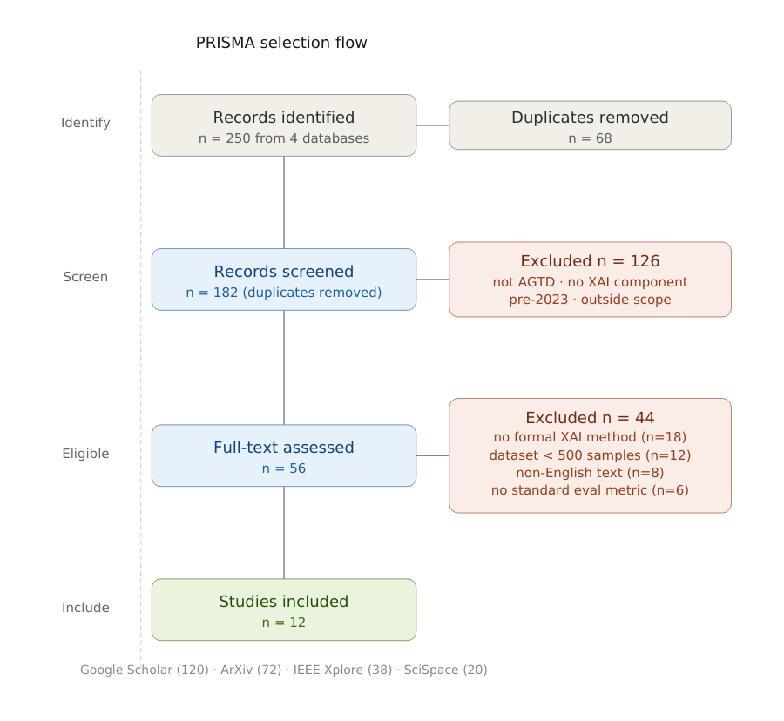
03 / Methodology
PRISMA Systematic Literature Review
Search
Google Scholar, ArXiv, IEEE Xplore, SciSpace
Screen
Title/abstract → full text — two-stage filter
Criteria
2023–2026 · XAI method · ≥500 samples · English
Extract
Architecture, XAI tool, dataset, metrics, findings
QA
Peer review, F1/AUC reported, replication materials
Final result: 12 studies included from 250 identified

Slide 6
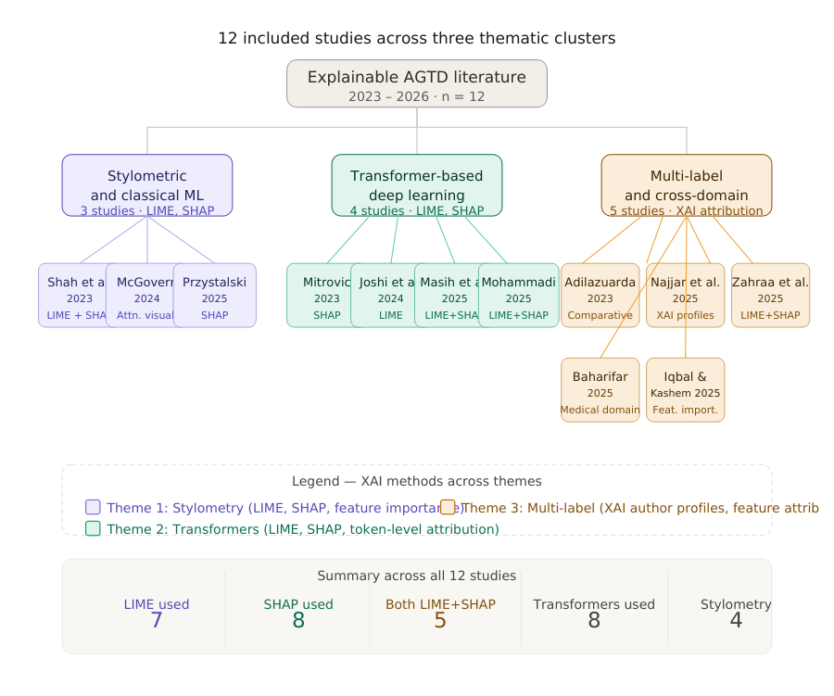
04 / Literature Review
12 Studies Across Three Thematic Clusters

Slide 7
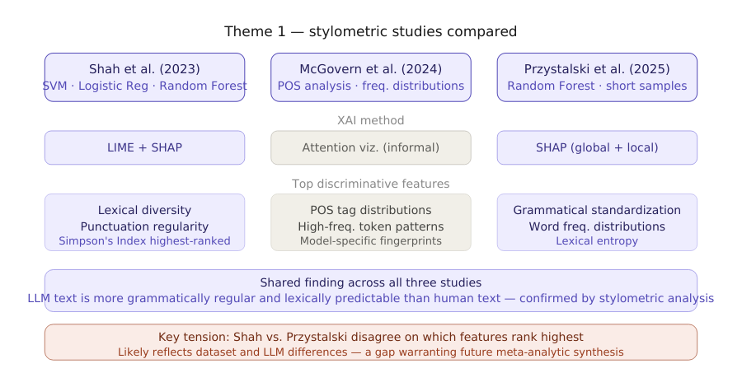
Theme 1 / Stylometric & Classical ML
Shah (2023) · McGovern (2024) · Przystalski (2025)
Shared finding
LLM text is more grammatically regular and lexically predictable than human text
LIME + SHAP agree
Simpson's Index, punctuation regularity and grammatical standardization are top features
Key tension
Shah vs. Przystalski disagree on exact feature rankings — dataset-driven difference
Stylometry remains effective even on short samples (< 200 words)

Slide 8
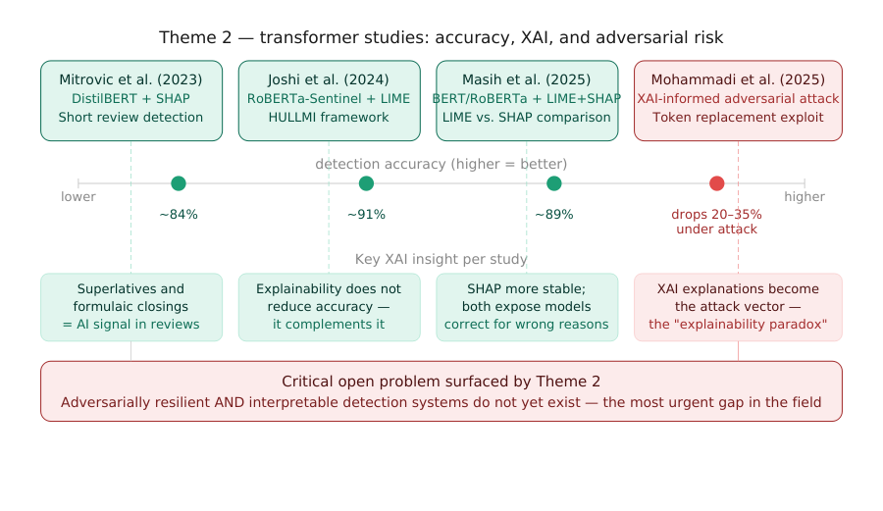
Theme 2 / Transformer-Based Deep Learning
Mitrovic · Joshi (HULLMI) · Masih · Mohammadi — 2023–2025
The Explainability Paradox — Mohammadi et al. (2025):
XAI-guided token replacement drops detector accuracy by 20–35% — transparency enables evasion

Slide 9
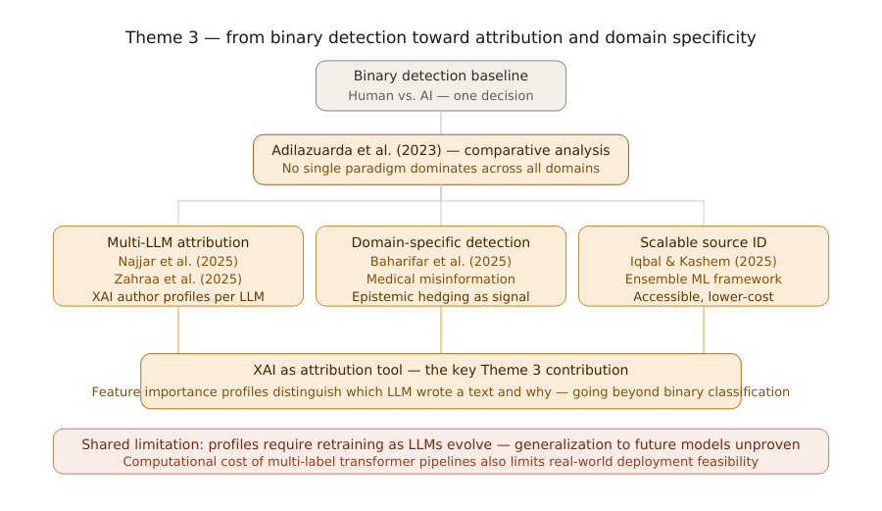
Theme 3 / Multi-Label Attribution & Cross-Domain
Adilazuarda · Najjar · Zahraa · Baharifar · Iqbal — 2023–2025
XAI as attribution
Feature profiles distinguish WHICH LLM wrote a text — not just human vs. AI
Domain specificity
Medical misinformation: absence of epistemic hedging is the strongest AI signal
No single winner
Adilazuarda: no paradigm consistently dominates across all domains

Slide 10
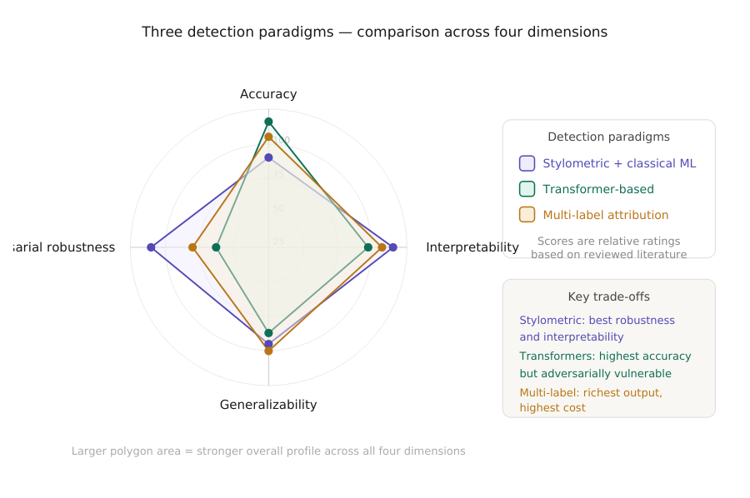
05 / Comparative Analysis
Three Paradigms — Four Dimensions
Stylometric
Best adversarial robustness & interpretability. Lower peak accuracy.
Transformers
Highest accuracy (~91%). Adversarially vulnerable when XAI is exposed.
Multi-label
Richest output — identifies source LLM. Highest cost, needs retraining.

Slide 11
05 / Comparative Analysis
What LIME & SHAP Consistently Find
Discriminative Feature | Studies Identifying It | Paradigm
Grammatical standardization | Przystalski, Masih, Baharifar | All three
Formulaic transitional phrases | Shah, Joshi, Zahraa | Stylometric + Transformer
Low lexical entropy / vocabulary | Shah, Przystalski, Iqbal | Stylometric + Ensemble
Superlatives & assertive constructions | Mitrovic, Baharifar | Transformer
Absence of epistemic hedging | Baharifar, Najjar | Multi-label + Domain
POS tag distribution anomalies | McGovern, Przystalski | Stylometric
Discourse-level over-smoothing | Joshi, Najjar | Transformer + Multi-label

Slide 12
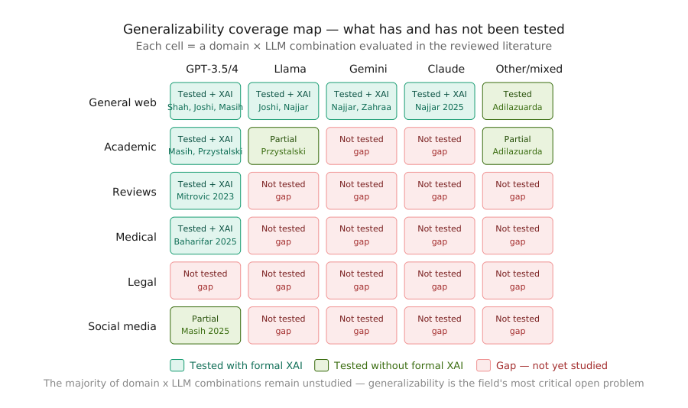
05 / Comparative Analysis
The Generalizability Problem
Stylometric:
Transformer:
Multi-label:
Feature drift across domains
Distributional shift across LLMs
Model version sensitivity

Slide 13
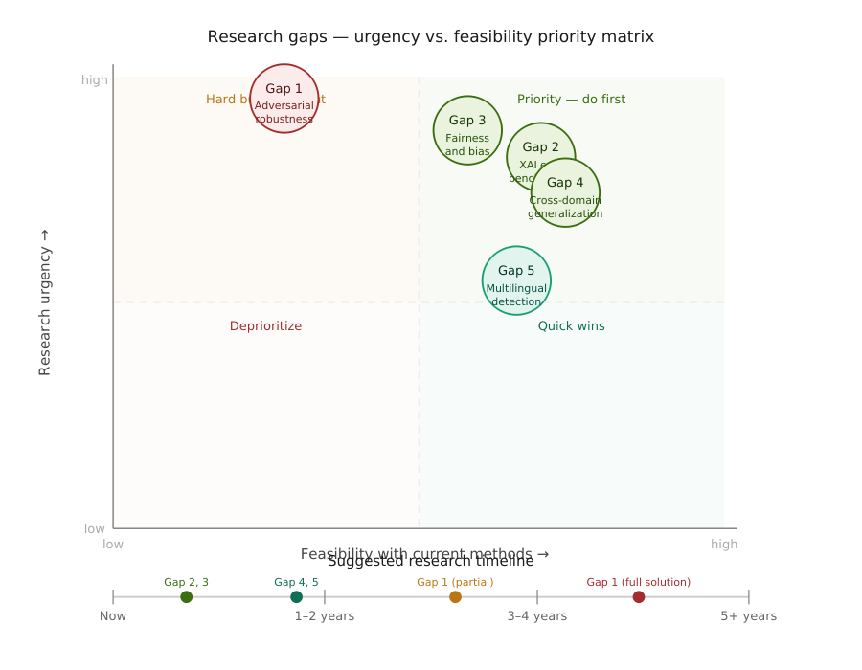
06 / Research Gaps & Future Directions
Five Priority Research Gaps
Gap 1
Adversarial robustness — XAI paradox unresolved
Gap 2
No standardized XAI evaluation benchmarks
Gap 3
Fairness & bias against non-native writers
Gap 4
Cross-domain and cross-LLM generalization
Gap 5
Multilingual explainable detection absent

Slide 14
07 / Conclusion — Key Takeaways
What This Review Establishes
01
Convergent validity
02
Accuracy + XAI are compatible
LIME and SHAP consistently identify the SAME core AI signals — grammatical standardization, formulaic language, low lexical entropy — across all three paradigms
Joshi and Masih demonstrate integrating XAI into transformer pipelines does NOT sacrifice classification performance
03
Generalization is the critical gap
04
The adversarial paradox is unsolved
No paradigm performs reliably outside its training domain — the majority of domain × LLM combinations remain completely untested
Transparency that makes detection trustworthy simultaneously makes it vulnerable — no current architecture resolves both

Slide 15
The Broader Significance
As AI-generated content becomes embedded in academic, journalistic,
medical, and legal discourse — the ability to detect and explain AI
authorship transparently is not merely a technical capability.
It is a governance requirement.
Accurate
Interpretable
Trustworthy
Reliable classification across LLMs and domains
Decisions that can be examined and challenged
Systems that are fair, robust, and accountable

Slide 16
Thank You
Questions & Discussion
Jawwad Ahmad | F25NDOCS3W04013
Supervisor: Dr. Ahmad Niaz — The Islamia University of Bahawalpur
MSCS Research Methods | April 2026

